Slide 1


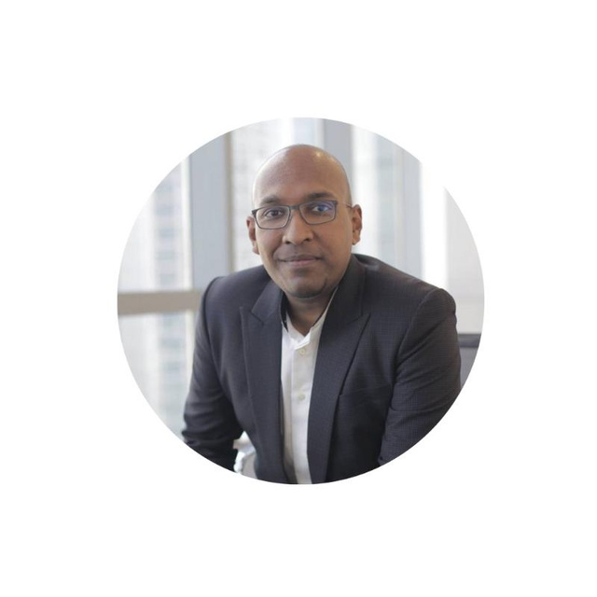


Keynote | [Social Intelligence Maturity] Building Social Maturity For Your Organisation
MIMRAH MAHMOOD
Senior Director & Partner
Meltwater
SINGAPORE | 27 OCTOBER 2022 | #THEMARTECHSUMMIT

Slide 2


LET’S LEAD WITH SOCIAL

Slide 3
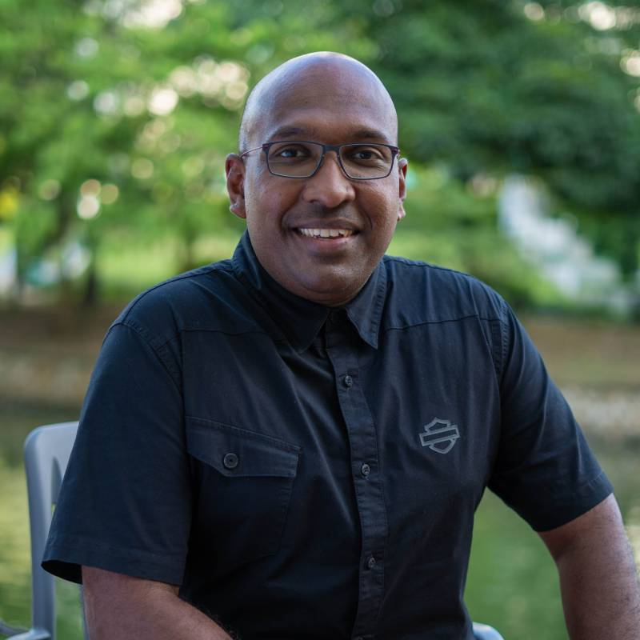
YOUR SPEAKER TODAY
MIMRAH MAHMOOD
Senior Regional Director & Partner
Meltwater

Slide 4


HERE’S WHAT WE’LL BE DISCUSSING
1
The Changing Customer Journey
2
The Role of the CMO
3
Evolving your MarTech Stack to Social Stack
4
The Social Maturity Model

Slide 5

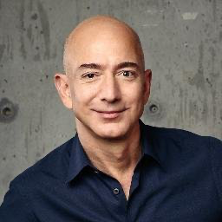
WHY IS SOCIAL MEDIA MORE IMPORTANT THAN EVER FOR THE CUSTOMER JOURNEY?
“
Social Media has shifted power relationships in retail. Recommendation algorithms, livestreaming by KOLs, and “native” (embedded online) e-commerce stores in TikTok have changed the traditional dynamic whereby a purchase begins with the customer’s search for a product.
”
Sept 2021
“
If you make customers unhappy in the physical world, they might each tell 6 friends. If you make customers unhappy on the internet, they can each tell 6,000 friends.
”
Jeff Bezos, CEO of Amazon
Notes:
Social is key component of customer buying journey / customer advocacy / increase retention rate / loyalty / repeat customers

Slide 6



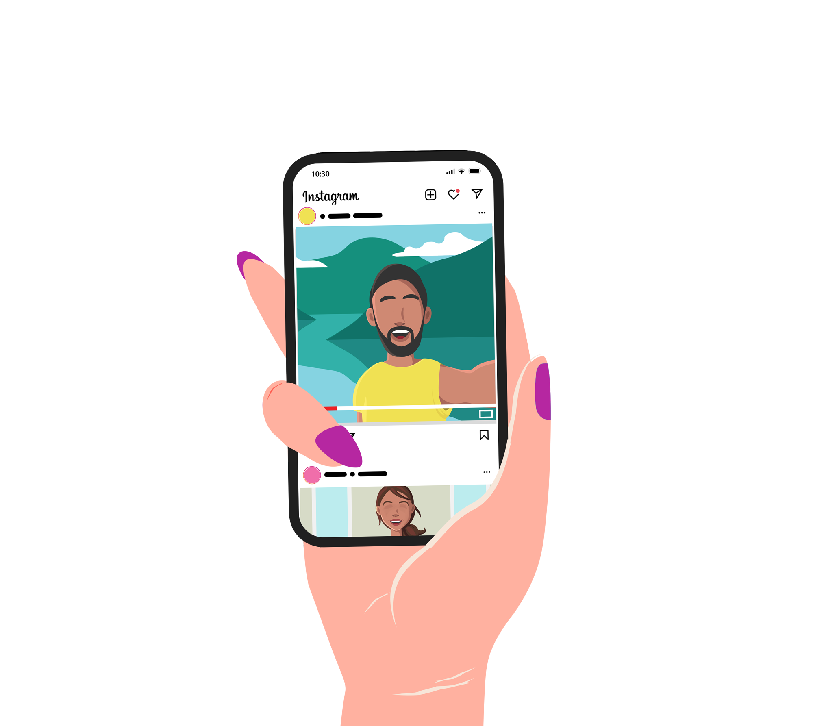
Aussie Consumers and Social Media
91% Australians have at least one social account
8/10 Australians interact with social ads
5/10 will be more likely to buy if the ads are contextually relevant to them
Source: Integral Ad Science 2022 Report

Slide 7


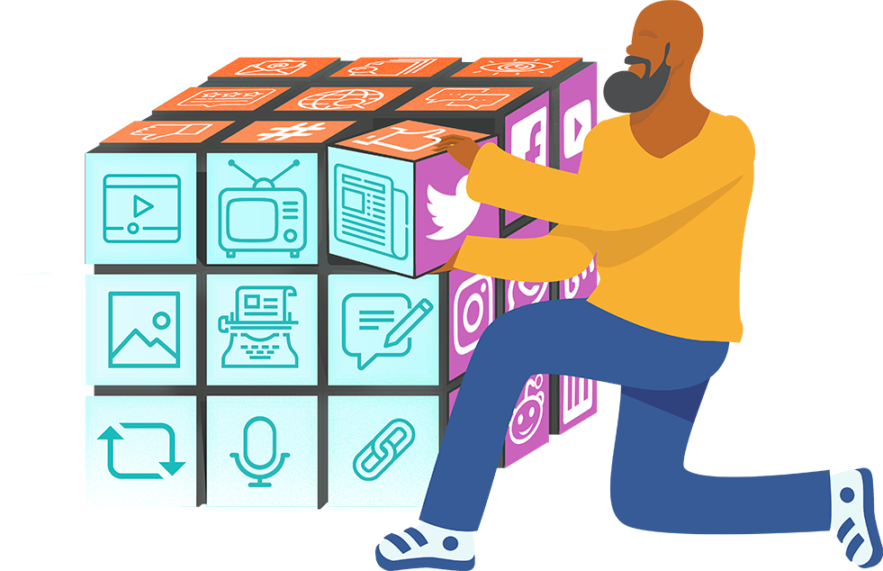
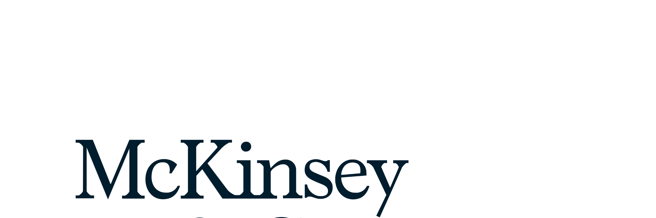
Social and the Aussie consumer
Global Context
45% of Australians say they conduct social media research before making a purchase
In the USA, consumers conduct 50-80% of research and purchases through online.
We are seeing Australians embrace digital channels at a higher rate than ever before, but we still have ample room for online and omnichannel expansion.
Source: McKinsey Emerging cautiously: Australian consumers in 2022

Slide 8

THE NEW CUSTOMER JOURNEY
Social Ads, e.g., LinkedIn
Sharing after purchasing – vlogs, unboxing
Customer Loyalty Programs
PPC, SEM, SEO
Webinars
Email
Campaign,
Newsletter
Events, Expos
Social Shares
Website
AWARENESS
CONSIDERATION/ EVALUATION
PURCHASE
CUSTOMER EXPERIENCE
LOYALTY
PR
Case Studies
Website
Chat
Masterclasses,
Webinar, Events
Executive Dinner,
Executive Lunches,
Workshops
Referrals,
Word of Mouth through Social
Blog, E-Books,
Whitepaper, Webinar
Review Sites,
Customer Testimonials,
Video Tutorials
Social Advocacy
Notes:
Highlight-
Social Media
Review Sites
Customer testimonials
Social
Highlight elements that are social
Pre 2020 and post 2022
Pre 2020 – social elements were lesser
2022 and beyond – more prominent
Focus only on social ones - every other moves to the side
Highlight
Referrals
WOM through social
LinkedIn Ad
Social – sharing after purchasing, vlogs, unboxing

Slide 9
PR / Media
team
Marketing
Branding
AWARENESS
Product
team
CX / Voice-of-the-Customer team
Retail
CONSIDERATION
PURCHASE
Customer Care
Consumer Research
Data and Analytics
LOYALTY
Notes:
A unique opportunity for Consumer Insights to lead the change
Within this new landscape, the Consumer & Marketing Insight function (CMI) has both the responsibility and a unique opportunity to lead the required change within the marketing departments of global brands.
Your fundamental task is to support the changes underway in the marketing team and the new way of marketing:
You must enable customer insight and research to feed into the new agile, facts-driven, data-driven and consumer-first mode of marketing
You must ensure that your intimate, and rigorously constructured, knowledge of the customer, brands and markets is readily accessible and explorable across the organisation.
You must empower your internal stakeholders to make more authentic connections with consumers through deeper understanding of behaviors, mindsets and habits and what makes products and brands truly stand out.
You must provide a shared framework of measurement which allows for comparison, consistency and trust between stakeholders producing and leveraging consumer data
The emergence of new methodologies is calling into question the traditional CMI role. The increasing number of stakeholders, both internal and external, means it is more difficult to be heard by your CMO and the board. Consultancy firms with access to the CEO might want to encroach on your strategic authority, while internal functions with direct access to multiple data sources threaten to demonopolize consumer insights.
You must provide a standardized, widely-accepted and shared solution, where metrics and measurement processes are consistent across brands, teams and locations.
Top line learnings are not enough; deep understanding of the consumer and insights which can be turned into real, strategic business recommendations must be at the heart of the new model.
The results must be actionable and applicable to teams across the organizations. Consumer insights are no longer nice to have. Consumer insights are part of your business strategy.
Change happens fast and you must find a way to capture it real time, before competitors catch up and you lose the advantage.
Spontaneous and unbiased consumer feedback should be the driver. Only organic conversation, happening without a brand being present, offers a unique consumer point of view reflecting their reality, needs and demands. You must listen first, then action.

Slide 10

Organization-wide utilization of social –
Social is no longer a siloed approach
Marketing
PR / Media
team
Consumer Research
Branding
Product
team
Retail
Customer Care
Your Company
Market Research
Data and Analytics
CX / Voice-of-the-Customer team

Slide 11
ONLY 36% OF ASEAN BUSINESSES UTILIZE SOCIAL MEDIA BEYOND TWO DEPARTMENTS

Slide 12

What is your MarTech stack?
ASKS FROM THE CMO
What is your MarTech Stack?
Notes:
Image of CMO
Asking for Martech stack (speech bubble)
Example of Martech stack
Also asking for social stack (4 slides) -

Slide 13
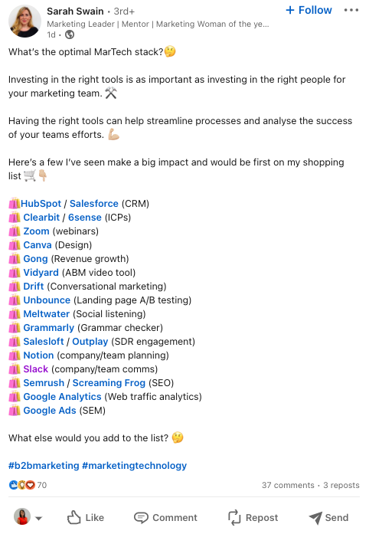
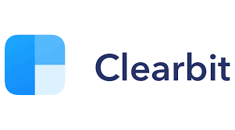



















MARTECH STACK
Function
CRM
ICPs
Webinars
Design
Revenue Growth
ABM Video
Conversational Marketing
Landing Page
A/B Testing
Tool
Function
Social
Grammar Checker
SDR Engagement
Company/ Team Planning
Company/ Team Comms
SEO
Web Traffic Analytics
SEM
Tool
Notes:
Image of CMO
Asking for Martech stack (speech bubble)
Example of Martech stack
Also asking for social stack (4 slides) –
🛍️HubSpot / Salesforce (CRM)
🛍️ Clearbit / 6sense (ICPs)
🛍️ Zoom (webinars)
🛍️ Canva (Design)
🛍️ Gong (Revenue growth)
🛍️ Vidyard (ABM video tool)
🛍️ Drift (Conversational marketing)
🛍️ Unbounce (Landing page A/B testing)
🛍️ Meltwater (Social listening)
🛍️ Grammarly (Grammar checker)
🛍️ Salesloft / Outplay (SDR engagement)
🛍️ Notion (company/team planning)
🛍️ Slack (company/team comms)
🛍️ Semrush / Screaming Frog (SEO)
🛍️ Google Analytics (Web traffic analytics)
🛍️ Google Ads (SEM)

Slide 14

ASKS FROM A MODERN CMO
What is your Social Stack?
Notes:
Image of CMO
Asking for Martech stack (speech bubble)
Example of Martech stack
Also asking for social stack (4 slides) -

Slide 15
MARTECH STACK
Function
CRM
ICPs
Webinars
Design
Revenue Growth
ABM Video
Conversational Marketing
Landing Page
A/B Testing
Tool
Function
Social
Grammar Checker
SDR Engagement
Company/ Team Planning
Company/ Team Comms
SEO
Web Traffic Analytics
SEM
Tool
Notes:
Image of CMO
Asking for Martech stack (speech bubble)
Example of Martech stack
Also asking for social stack (4 slides) –
🛍️HubSpot / Salesforce (CRM)
🛍️ Clearbit / 6sense (ICPs)
🛍️ Zoom (webinars)
🛍️ Canva (Design)
🛍️ Gong (Revenue growth)
🛍️ Vidyard (ABM video tool)
🛍️ Drift (Conversational marketing)
🛍️ Unbounce (Landing page A/B testing)
🛍️ Meltwater (Social listening)
🛍️ Grammarly (Grammar checker)
🛍️ Salesloft / Outplay (SDR engagement)
🛍️ Notion (company/team planning)
🛍️ Slack (company/team comms)
🛍️ Semrush / Screaming Frog (SEO)
🛍️ Google Analytics (Web traffic analytics)
🛍️ Google Ads (SEM)

Slide 16
















SOCIAL STACK – PORTFOLIO COMPANY
Capability
BRAND #1
BRAND #2
BRAND #3
BRAND #4
BRAND #5
BRAND #6
Listening
Publishing
Moderation
Platform Specific Analytics
Influencer / EMV
Social Commerce
Content
Notes:
(ANONYMISED) Shiseido social stack

Slide 17




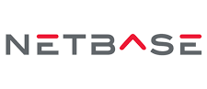

SOCIAL STACK – GLOBAL BRAND
Functional area
Listen
Competitor Analysis
Post & Engage
Moderate
Display & Internal Operations
Customer Care & CSAT
Premium News Listening
Paid
Media
Manage Influencers
Path to Purchase Ecommerce
Data Visualisation
Database Enrichment
Approved vendor
Department
Social Media
Marketing Analytics
Customer Engagement
CX
Public Affairs
PR
Media Planning & Operations
Digital Marketing
Social Media
Sponsorship
Marketing
Social Media
Social Media
Media Planning & Operations
Digital Marketing
CX
Brand
Marketing Operations
Social Media
Marketing Operations
Marketing Analytics
Digital Marketing
Social Media
Notes:
(ANONYMISED) Coca Cola social stack

Slide 18
LEADING IN SOCIAL: THE CUSTOMER JOURNEY
Social Ads, e.g., LinkedIn
Sharing after purchasing – vlogs, unboxing
Customer Loyalty Programs
PPC, SEM, SEO
Webinars
Email
Campaign,
Newsletter
Events, Expos
Social Shares
Website
AWARENESS
CONSIDERATION/ EVALUATION
PURCHASE
CUSTOMER EXPERIENCE
LOYALTY
PR
Case Studies
Website
Chat
Masterclasses,
Webinar, Events
Executive Dinner,
Executive Lunches,
Workshops
Referrals,
Word of Mouth through Social
Blog, E-Books,
Whitepaper, Webinar
Review Sites,
Customer Testimonials,
Video Tutorials
Social Advocacy
Notes:
Highlight-
Social Media
Review Sites
Customer testimonials
Social
Highlight elements that are social
Pre 2020 and post 2022
Pre 2020 – social elements were lesser
2022 and beyond – more prominent
Focus only on social ones - every other moves to the side
Highlight
Referrals
WOM through social
LinkedIn Ad
Social – sharing after purchasing, vlogs, unboxing

Slide 19

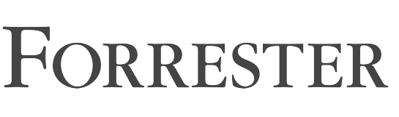
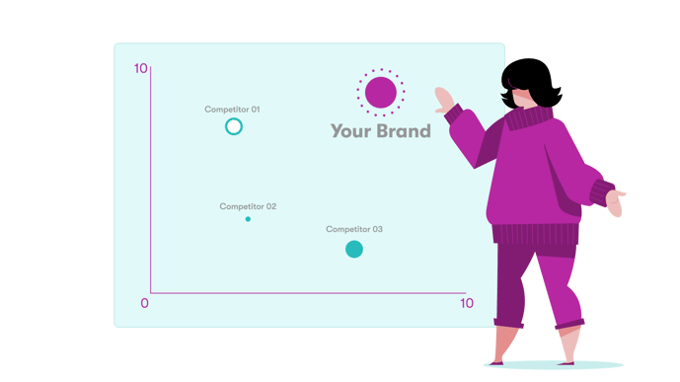
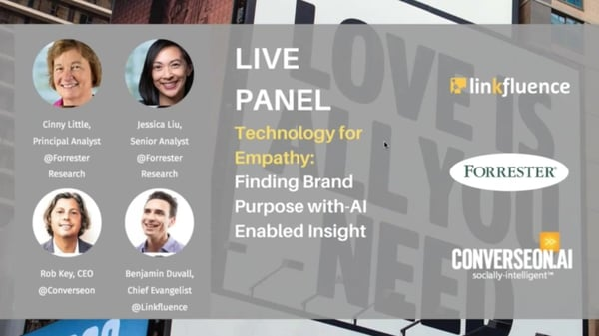
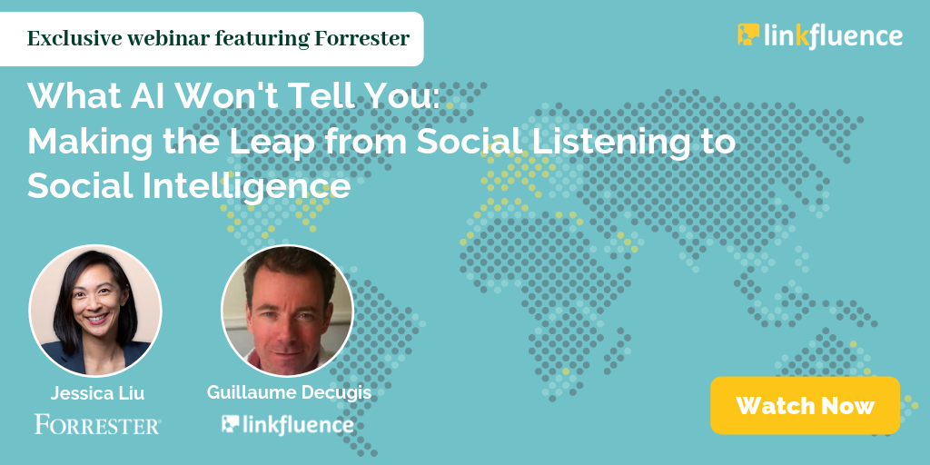
Customers who wish to succeed in the new world,
need to be social-first.
PARTNERSHIP
SOCIAL MATURITY MODEL
x

Slide 20




THE ROADMAP TO SOCIAL MATURITY
Integrate
Combine
Integrating social and customer data in the customer database through social listening, appending existing records, or collecting customers’ social information through opt-ins
Inspire or validate
Combining social
and traditional customer data through dashboards, scorecards, or custom metrics
Monitor
Inspiring or validating customer insights with social data
Monitoring social media
Crawl
Walk
Run
Fly

Slide 21
THE ROADMAP TO ENTERPRISE CONSUMER INTELLIGENCE
10
Pernod Ricard
D
ANONE
Adoption
NIKE
KERING
Application
EPIC Games
LVMH
Häagen-Dazs
24-month target
Converse
12 month target
0
Execution
10
Crawl
Walk
Run
Fly

Slide 22
USE THE 4PS
TO BUILD YOUR INTELLIGENCE PRACTICE
PEOPLE
PURPOSE
Specialists assigned to the tasks
Skilled in managing data
Skilled in interpreting data
  Integrated into business goals
  Needs to have a mechanism to measure goals
4PS
WAVE
INDUSTRY MATRIX
PLATFORM
PROCESS
    Tools in place to ensure you have the right content
    Data presented in the right way that addresses the most common use cases
    Compliance and governance frameworks
    Frictionless workflow – which insights go where?
Notes:
People
Specialists assigned to the task
Skilled in managing the data
Skills in interpreting the data
Purpose
Integrated into company’s biz goals
Needs to have a mechanism to measure goals
Platform
Tools that you have in place to ensure you have the right type of content
The way the data is presented – addresses most common use cases
Process
Compliance and government framework so you can handle the new data coming in
Frictionless workflow how to distribute which insights go to which person

Slide 23


A COMPLETE INTEGRATION OF SOCIAL DATA IN THE DIGITAL TRANSFORMATION JOURNEY
Making social insights and analytics the driving force behind all business and strategic decisions, from Marketing, Product R&D, Consumer Research and Customer Experience.
Notes:
One Time to Real Time: transitioning to on-going data reads vs. massive one-time reports
Predictive vs reactive: isolating and vetting true predictors of demand
Wiring in to Core business processes: Plugging into Finance so that we are also creating a deliverable that finance can use in annual planning, or creating competitor packets for Pricing to inform their studies.
True partners: Insights kicks off the brand planning process, not just participate
By taking insights and analytics into Transformation and outside of Marketing, it means insights is in the drivers seat. My role specifically is taking strong insights work and making sure it is used outside of marketing

Slide 24

Notes:
One Time to Real Time: transitioning to on-going data reads vs. massive one-time reports
Predictive vs reactive: isolating and vetting true predictors of demand
Wiring in to Core business processes: Plugging into Finance so that we are also creating a deliverable that finance can use in annual planning, or creating competitor packets for Pricing to inform their studies.
True partners: Insights kicks off the brand planning process, not just participate
By taking insights and analytics into Transformation and outside of Marketing, it means insights is in the drivers seat. My role specifically is taking strong insights work and making sure it is used outside of marketing

Slide 25

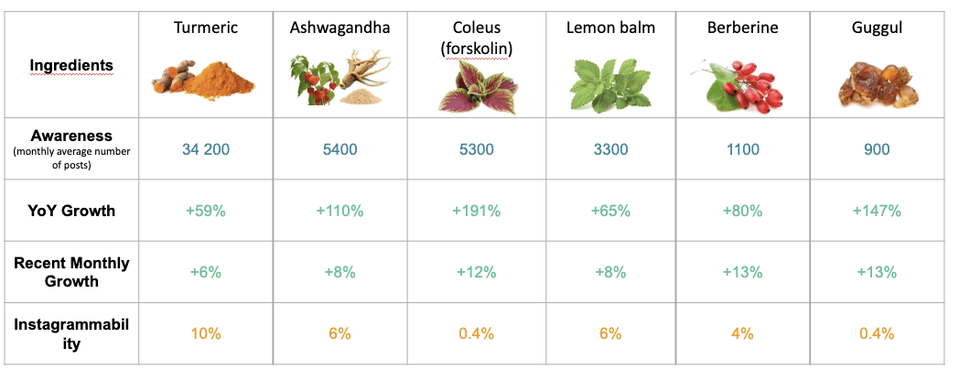
SO HOW DID THEY EXECUTE?
Turmeric
Ashwagandha
Coleus
Lemon Balm
Berberine
Guggul
Ingredients

Slide 26
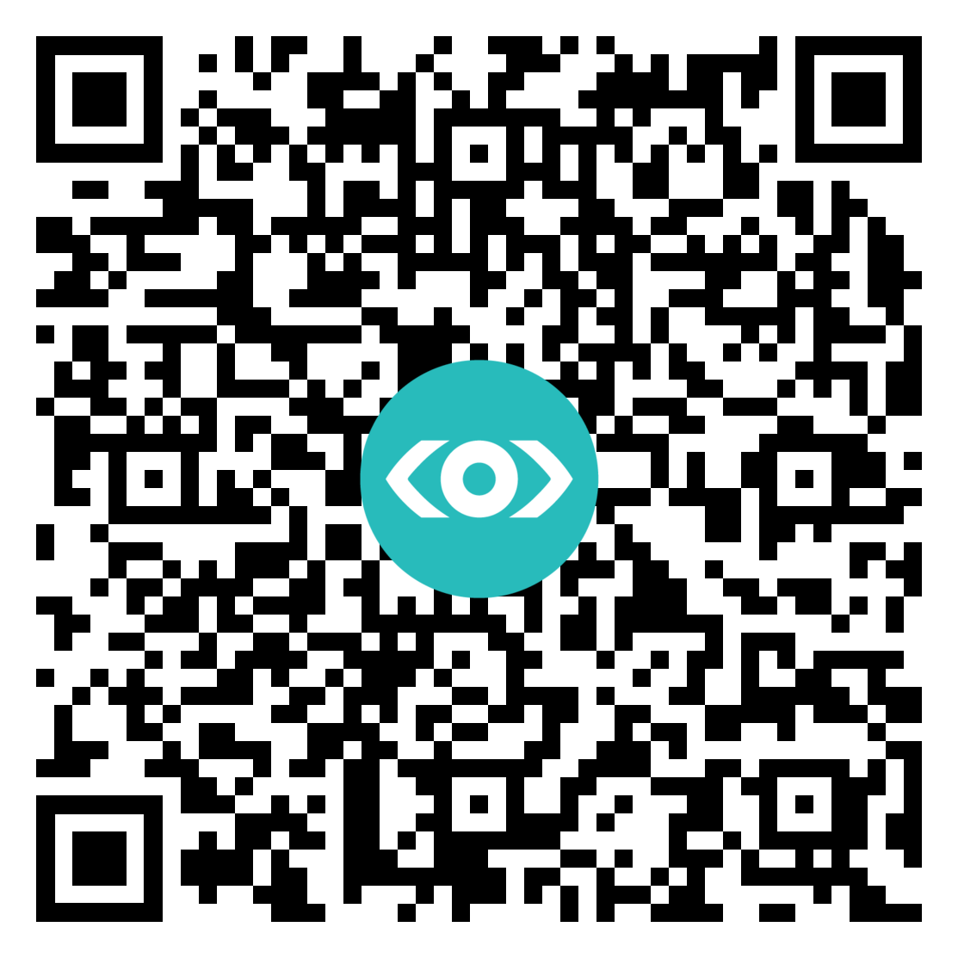


Q&A
Scan QR code to get a free maturity model assessment for your team
CONNECT WITH MIM
mim@meltwater.com
linkedin.com/in/mimrah/
Notes:
https://learn.meltwater.com/apac-en-event-martechsummit271022_Demo-LP.html

Slide 27

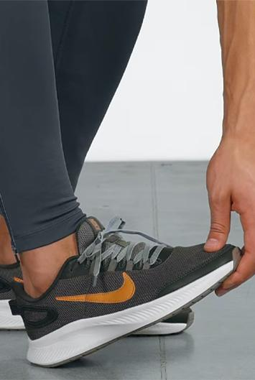
Activate and connect with tribes
⚠️ Not for public use! Sharing publicly can result in contract termination
TRIBES
We help Nike identify, understand, and activate their tribes across the globe.
Challenge:
Understand how consumer perceptions are impacted by Nike-sponsored athletes and brands, and how their perceptions are informed by the culture and lifestyles of different social groups.
Solution:
100m+ public social media profiles ranked across 6m+ topics through machine learning
Sports and fashion tribes revealed with shared interests
Lifestyle topics, activities, and brands affinities identified
Impact:
Modelled Tribes and identified which Nike athletes resonated with tribes across topics like social consciousness, sneaker culture, fashion, and others
Trained cross-functional teams on Tribes analytics
Provided insight reports for Nike to share with their athletes to help shape communication strategies

Slide 28

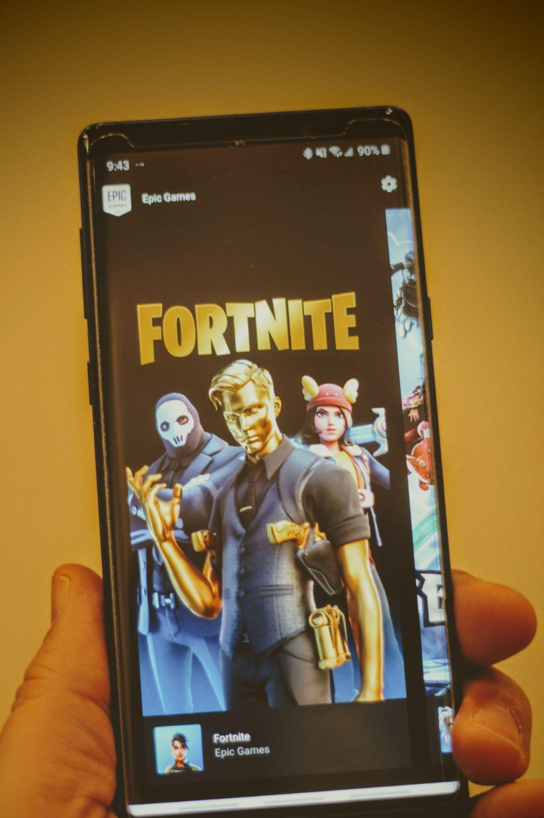
Connect with gamers in authentic ways
⚠️ Not for public use! Sharing publicly can result in contract termination
TRIBES
BRANDS
We help Epic Games understand the player experience through the lens of quantitative and qualitative analytics.
Challenge:
Epic Games wants to understand player experience for their games and their top competitors so they can provide best-in-class gaming experiences to various audiences
Solution:
Radarly is used to understand player experiences from a community management and UX team perspective
Tribes is used to understand how Fortnite players discuss games and experience the world beyond gaming
Brands is used to help Epic Games measure the brand equity of the top games in North America
Impact:
With the insights from Radarly, Brands. Tribes, and Linkfluence Insight Team reports, Epic Games is able to improve player experience and tailor marketing and digital events with an authentic brand voice

Slide 29
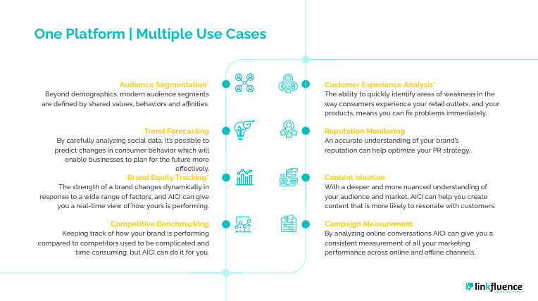

Slide 30
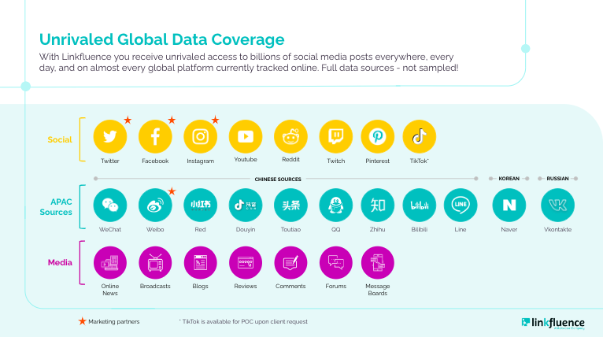

Slide 31
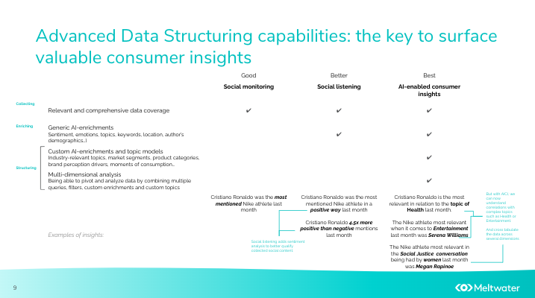

Slide 32



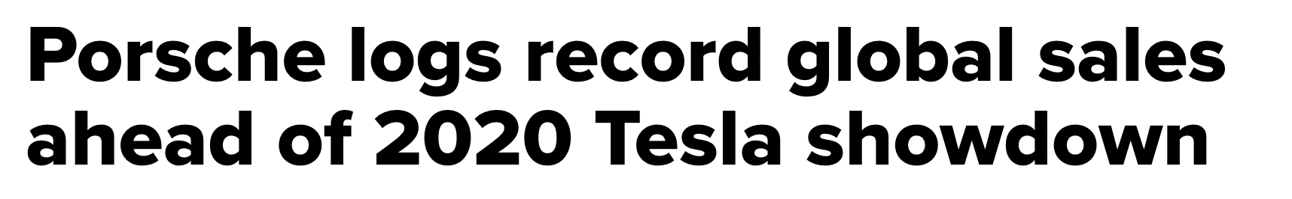
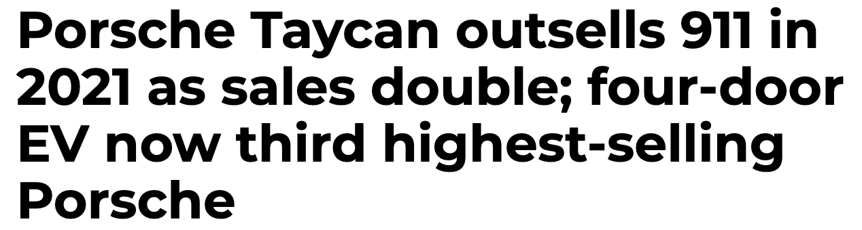

[Exploring] Creating more impactful campaigns
We helped Porsche launch the Taycan and change perceptions of its brand.
Challenge:
Porsche is pursuing a strategic repositioning from a premium to a contemporary luxury brand, while targeting new customers for its electric vehicles.
Solution:
Radarly deployed worldwide across its main markets, teams and agencies. In order to help:
Generate more impactful campaigns
Amplify campaign reach by optimizing messages and channels
Impact:
4-5x growth in content engagement and reach as the Taycan launched (Twitter/YouTube)
57% Share of Engagement over Q3 (ahead of Tesla) across all platforms and against direct competitors

Slide 33

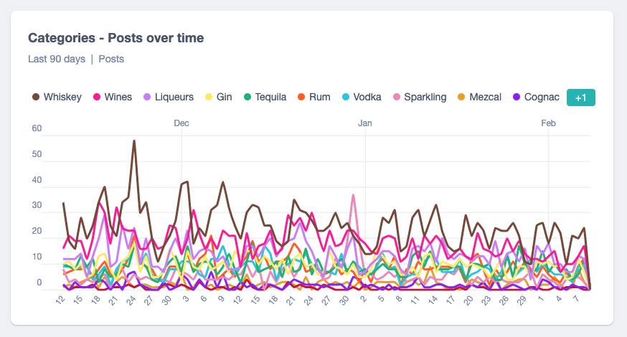

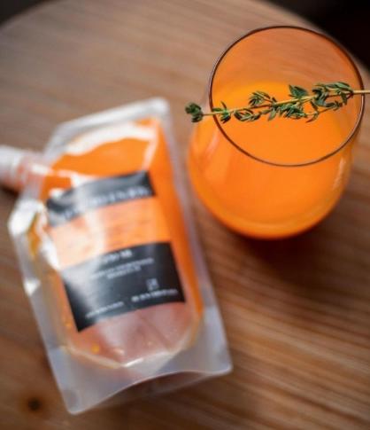

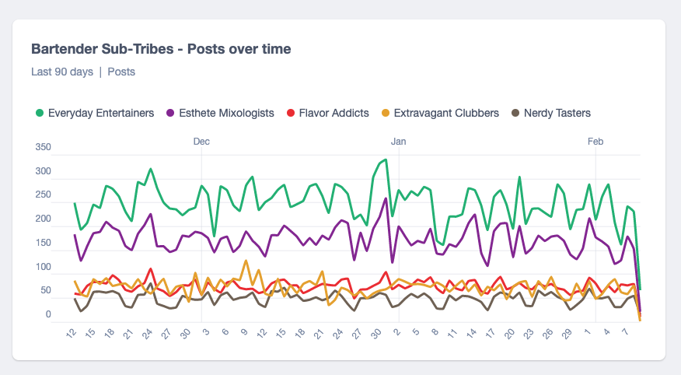
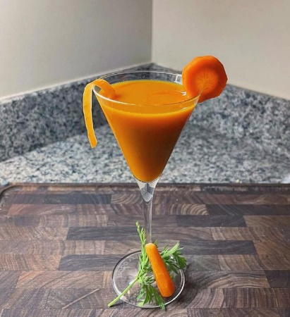
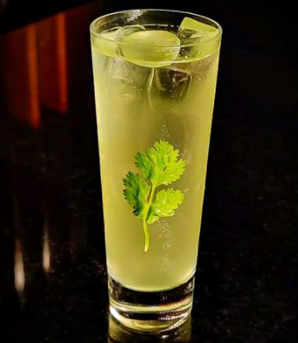
[Disrupting] Translating millions of conversations into actionable qualitative insights
A tangible “disrupting” example from Pernod Ricard’s Transformation office
Social Intelligence Data
Qualitative Insights
A “healthier” veggie and nutrient rich cocktail
It’s your guilty pleasure when health is the first thing on your mind!
Sub-Tribe
Sub-Tribe
Sub-Tribe
Sub-Tribe
Sub-Tribe
Carrots are good for your eyes & you just found one more way to get your daily intake. Gotta stay sharp after all yeah? 😉🥕🌿🍸
The Indian gooseberry, commonly known as Amla has eight times more vitamin C than an orange and around 17 times that of a pomegranate.

Slide 34
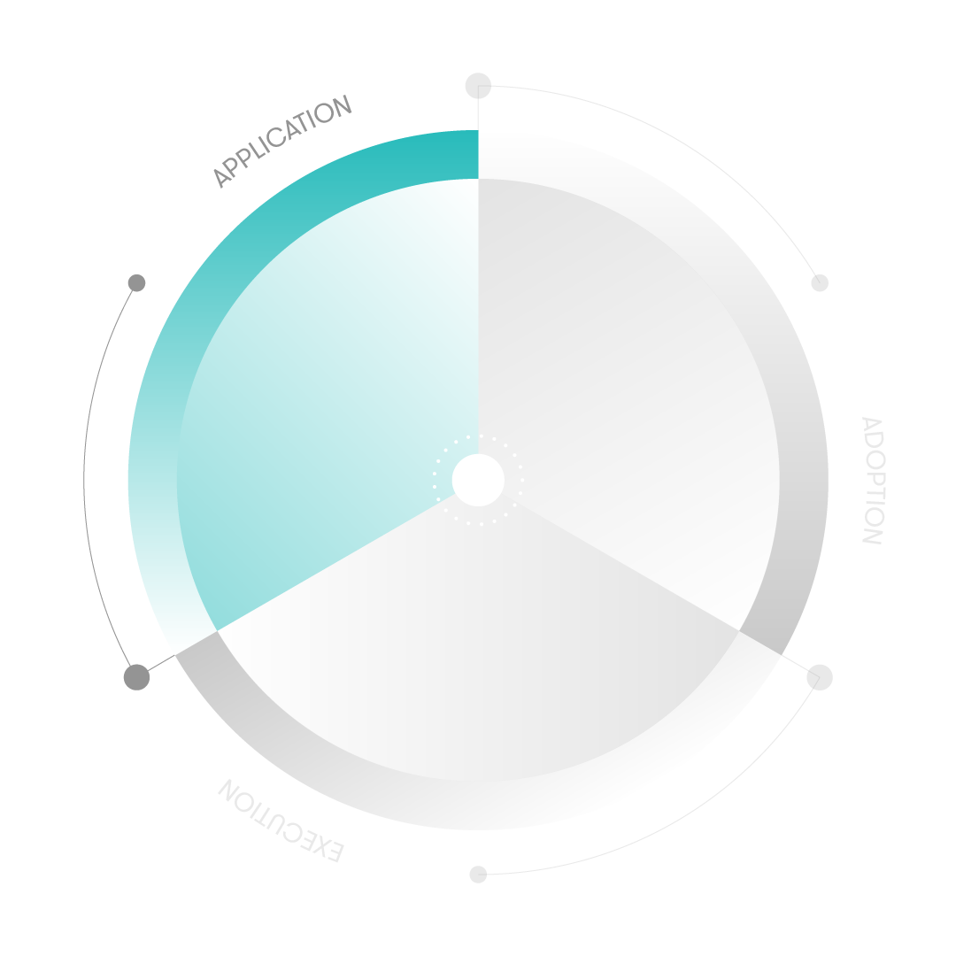
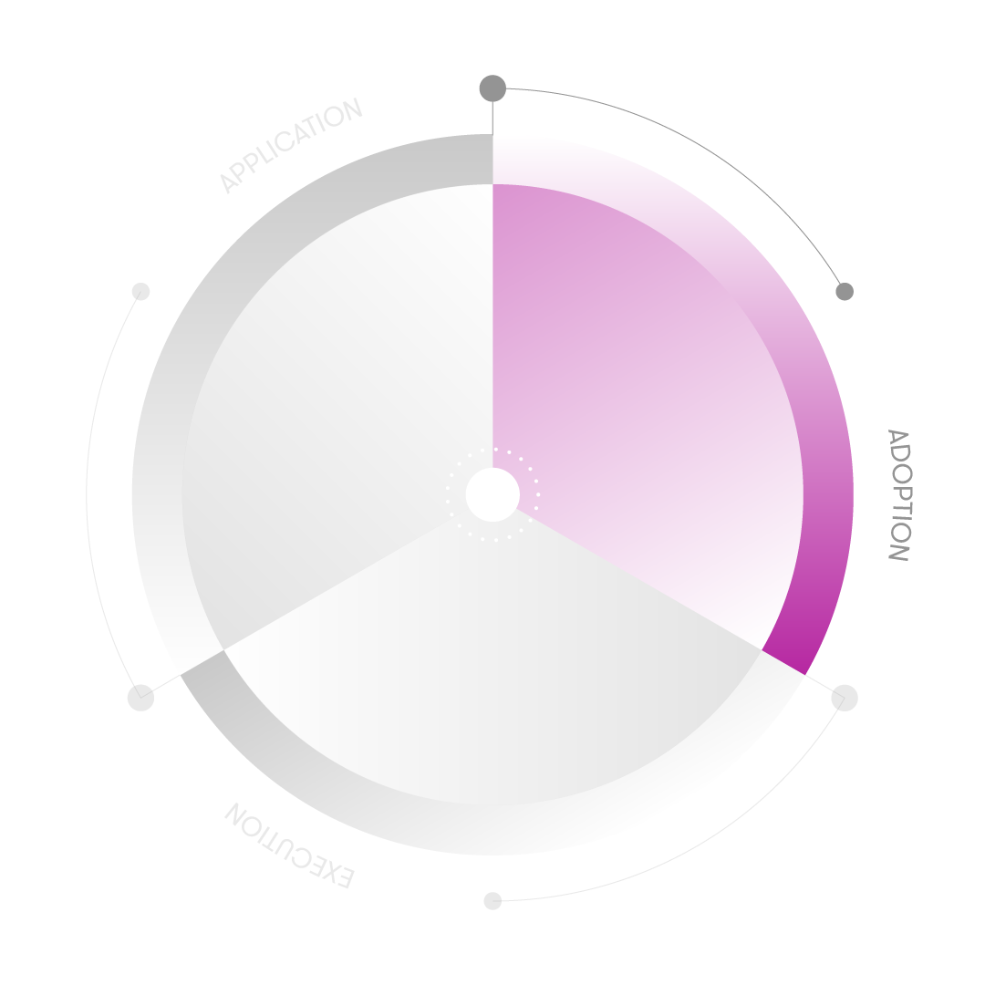
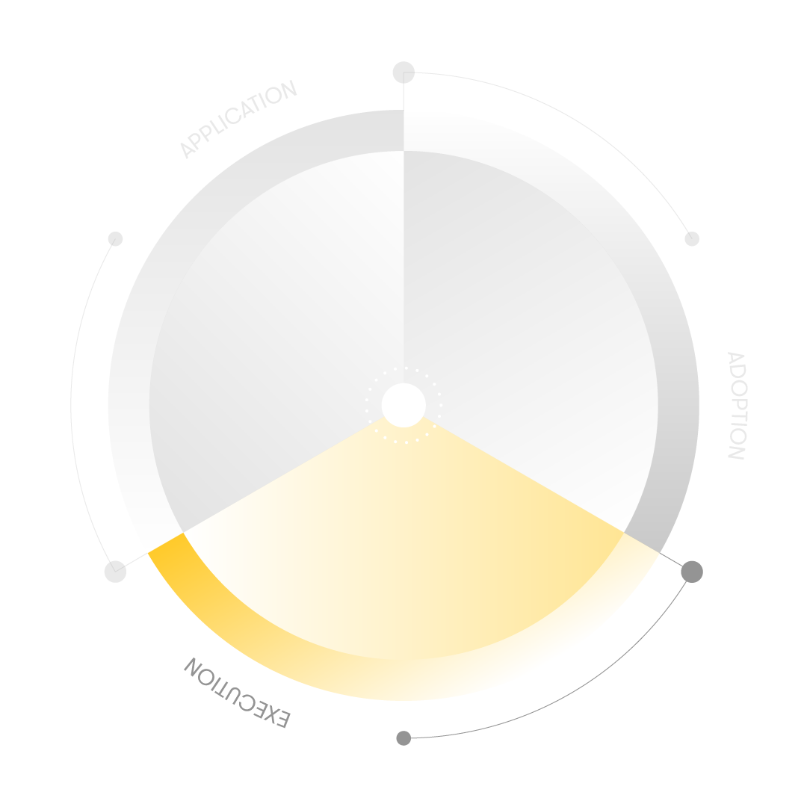
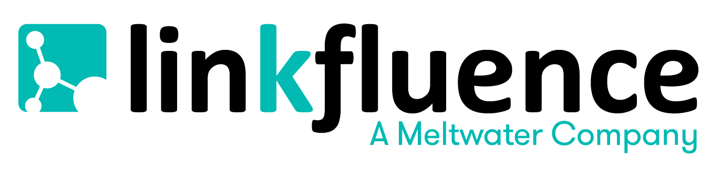
How we assess Social Intelligence maturity
A set of 9 predefined and ponderated questions based on three pillars. Addressed to each data project.
APPLICATION
ADOPTION
EXECUTION
Extent to which an entity uses consumer intelligence across various uses cases or applications, and how advanced these applications are
The size of staff in the organization using consumer intelligence, deployment across teams, and leadership dedicated to implementation
Types of business outcomes achieved, insight sharing across the organization as well as the use of non-social network data

Slide 35
Growing your brand’s maturity with social data
Through Adoption
Through Decisions Made
Brands
Tribes
Customer Experience
Trends
Consumer Insights
PR & Comms
Marketing & Brand
Digital Operations
Customer Experience
Strategic Planning
Media
New product decisions
Product volume forecasting
Mergers and acquisitions
Media investments
Audience segmentation
Market resource allocation
Content strategy
Brand strategy
Market Research
Departments
Reputation Management
Competitive Benchmark
Content
Influencers
Campaigns
Social Listening
Markets/regions
Brands/products
Through Use Cases

Slide 36

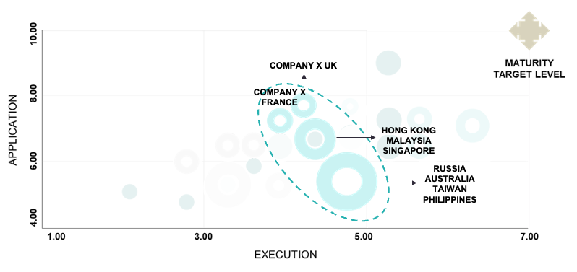
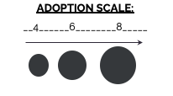
Linkfluence client empowerment plans
Helping our clients improve social intelligence maturity through hands on sessions
Example Progress Check
Company X Main Entities
Company X Regions
Company X Main Markets
Company X Small Markets
CMA Methodology: 3 Pillars (Application, Adoption, Execution). 21 Questions, Questions are ponderated, depending on their importance.

